Slide 1
Dreamweaver
Bill Pegram 1/27/2020

Slide 2
Topics covered
Creating absolute and relative links in Dreamweaver
Creating absolute and relative links of images in Dreamweaver
Site definition in Dreamweaver

Slide 3
Absolute and Relative Links
Absolute links – e.g. <a href=http://www.billpegram.com>Site</a> -- are the way you will link to other websites
Relative links – e.g. <a href=“work.html”>Work</a> are the preferred way of linking within your own site for several reasons
Link can be tested without being connected to the internet
Link can be tested without the destination page being uploaded to the internet
Most importantly, using relative links makes your site more portable – you can host the site at multiple domains and not need to change the link

Slide 4
Creating Absolute Links in Dreamweaver Design View
Using the Properties Panel
Make sure the Properties Panel is open by choosing Window>Properties – if the Properties panel is already open, there will be a check mark in front of “Properties”. This serves as a toggle; clicking Properties when there is already a checkmark will hide the panel.
Select the text you want to make a link and then in the link section of the Properties panel, enter the destination url, i.e. where the user will go if they click on the link. The url must include http://; otherwise it will be interpreted as a link to a file on the same computer. Although the URL can be typed, it is better practice to go to destination page in the browser and then copy and paste the URL into the link section; that way you know you have the correct URL.

Slide 5
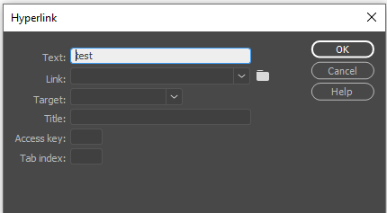
The Properties panel
Alternatively, absolute links can be created by selecting the text of the link and then choosing Insert>Hyperlink.
As before one either types in the text of the link, or better yet, goes to the destination page in the browser and then copies and pastes the URL into the Link box. When doing the latter, it seems that the requisite http:// is placed in the link box whether or not the URL was displaying the http://

Slide 6
Creating Relative Text Links in Dreamweaver
Although the appropriate relative link can be typed into either the link section of the Properties panel or the link section of the dialog box, it is quicker and less error prone to browse for the appropriate link, particularly if the destination is in a different folder than the page you are coming from.
On the Properties panel, one clicks the folder icon to the right of the link textbox and then browses to the appropriate folder and file.

Slide 7
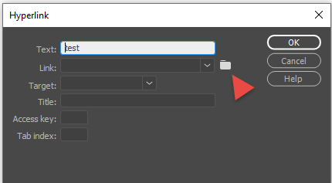
Creating Relative Text Links in Dreamweaver (cont.)
Alternatively, one can create relative text links by clicking on the folder icon in the Insert>Hyperlink dialog box and browsing for the folder and file

Slide 8
Making an Image into a Link in Dreamweaver
Instead of highlighting text to become the link, click on the image. If you are using the Properties panel, the choices will change to those appropriate for an image. You then create the absolute or relative link the same was as you would for a text link.
If you are not using the Properties panel, then click on the image and select Insert>Hyperlink and either put the absolute link into the link textbox or click on the folder and browse for the destination of the link to create a relative link.

Slide 9
Dreamweaver site definition
If you define a site within Dreamweaver, you can then rename or move files within your site and Dreamweaver will change any relative references affected by the change.
The renaming or moving of files must happen within Dreamweaver in the Files panel and not external to Dreamweaver such as in File Explorer.
To define a site within Dreamweaver, all that is necessary is to specify the root folder of the site. This is the folder that will contain all the files for the site but not a lot of other files. Thus the folder should not be “My Documents” or “Downloads”, etc.

Slide 10
Specifying the Local Site Folder in Dreamweaver

Slide 11
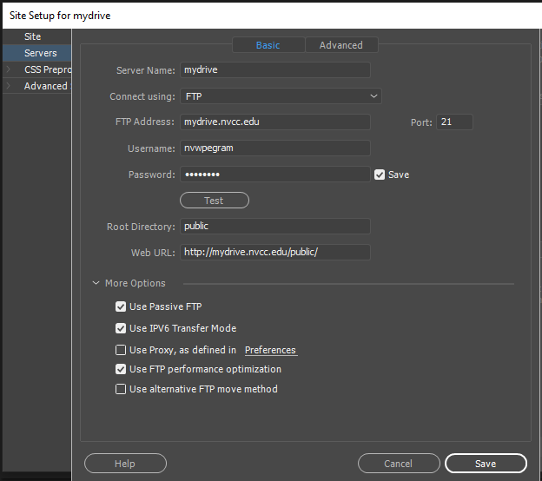
Using Dreamweaver to Upload Files
The folder you designate as the root folder of your site will not be uploaded but the contents of that folder will be uploaded.
In order to upload files from within Dreamweaver, the site definition must also specify server information -- the FTP address, the username, and the password; the same information that would be used in an FTP program such as WS_FTP.

Slide 12
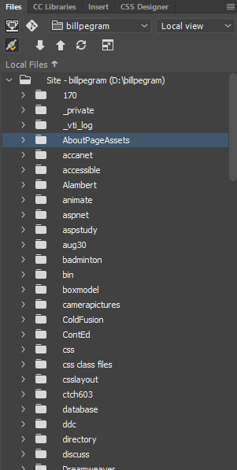
Uploading Files from within Dreamweaver
From the Files panel, select a folder or a file and click
the up (Put) arrow.

Slide 13
Uploading a file that you are working on
In Dreamweaver, select Window>Toolbars>Common. This acts as a toggle, so if Common is already checked, do not select it. At the far left, you should see an up and down arrow. If you don’t see these, click on the three dots to customize the toolbar and make sure that the File Management options are enabled.
You can work on a file, save it, and then click on the up arrow at the left to upload it. Because you have defined the site in Dreamweaver, the file will be uploaded to the correct location. Note the difference to an FTP program such as CoreFTP in which you need to be sure you are at the same level on the local site (computer) and the remote site (web) before you do an upload (or download) so that the files remain in the same relative location to each other and thus the relative links will work.

Slide 14
Specifying the root directory in the server definition
Some servers require you to place files in a particular folder in order for the files to be visible on a website. This can be done for security purposes; e.g. if there is a database used in the web application and this database is outside of the designated folder, then the database cannot be accessed by entering a URL into the browser.
On myDrive, in order for files to be viewed on the web, they must be placed within a folder named public which is at the top level of the site. Thus this folder is specified as the root directory in the Dreamweaver server definition; this means that Dreamweaver will upload files into this directory.

Slide 15
Site Definition in Dreamweaver for myDrive

