Slide 1
Domain Registration Copyrights and Patents
Revised: April 29, 2013

Slide 2
What is a Web Domain?
A HOSTNAME that identifies one or more IP addresses (web servers)
IP address (Internet Protocol) – identifier for a computer on the Internet
IP = four numbers separated by periods, like a phone number
Ex. nvcc.edu = 164.106.130.6
Domain names are Translated to IP addresses

Slide 3
How are Domain Names and IP addresses linked?
The Domain name (English-like name) and IP Address (numerical address) are linked with a DNS
DNS – Domain Name Server – job is to resolve the Domain name with the IP address
Similar idea to the contacts in your cell phone. Name - Number

Slide 4
How to register a domain
A domain name registry is a database of all domain names registered in a top-level domain.
Several domain name registrars e.g. GoDaddy, Network Solutions
Domain registration is inexpensive – approximately $10/year
What is ICANN?
The Internet Corporation for Assigned Names and Numbers (ICANN) is responsible for managing and coordinating the DNS to ensure that every address is unique and that all users of the Internet can find all valid addresses. It does this by overseeing the distribution of unique IP addresses and domain names. It also ensures that each domain name maps to the correct IP address.

Slide 5
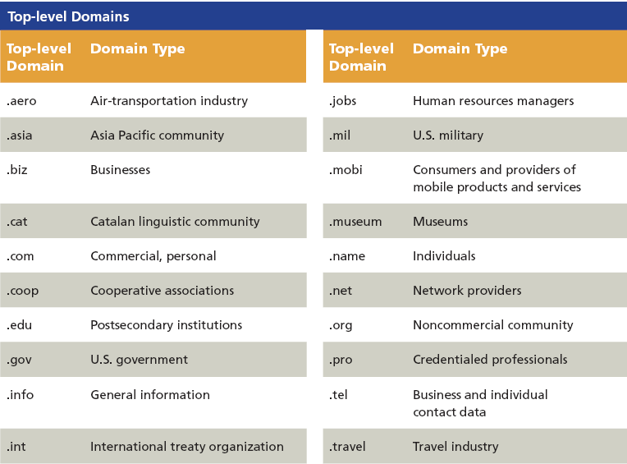
TLD – Top Level Domains
Notes:
Mention how .ADULT could be a solution to minors viewing adult material.

Slide 6
Additional TLDs
.xxx (Adult entertainment) – created in 2011
Country code top level domains – for example, .fr (France)
ICANN accepted applications for new generic top level domains – 1410 names applied for, some are companies (e.g. Microsoft) and some are generic (e.g. flowers) – often multiple applications for a generic one http://newgtlds.icann.org/en/ provides list
Cost is $185,000 to purchase and $25,000/yr to maintain
First approvals were in October 2013 – approved list is at http://newgtlds.icann.org/en/program-status/delegated-strings
Some trade associations oppose the generic top level domain concept; they see increased cost for business and confusion for consumers

Slide 7
From a GoDaddy 4/22/14 email
.guru – A natural choice for everything from advice blogs to how-to sites - $27.99
.email – A domain that sends a message the whole world understands - $17.49
.photography - Increase your exposure with a focus on photographers of all kinds - $17.49
.tips – A domain made for sharing your knowledge on virtually any topic - $17.49
.today – For websites that provide the latest information – news, weather, and more - $17.49
.solutions – They have problems. You have advice and the perfect domain - $17.49
.club – Made for clubs of all kinds. Tell potential members exactly what you have to offer. Starting at $14.99

Slide 8
Change in ICANN
ICANN has operated under a contract from the U.S. Department of Commerce. Commerce recently announced they would not be renewing the contract and thus U.S. control over this organization will decrease; Some are concerned that countries where the internet is tightly controlled will thus have increased influence over ICANN and the internet

Slide 9
Copyrights and Patents
Copyrights, patents, trademarks, and trade secrets are a type of intellectual property
A copyright grants the creator of an original work exclusive rights for a limited period of time
The period of time for a copyright varies by country; in the US, the copyright length is the creator's life plus 70 years for things published since 1978 or unpublished works
This is a longer period of time than existed previously
Copyrights apply to websites

Slide 10
Fair Use Doctrine
Permits some copying and distribution without permission of the copyright holder
Factors in fair use analysis:
The purpose and character of one's use
The nature of the copyrighted work
What amount and proportion of the whole work was taken, and
The effect of the use upon the potential market for or value of the copyrighted work

Slide 11
Patents
Patents give inventors exclusive rights to an invention for a limited period of time, usually 20 years
Why do patents have a much shorter duration than copyrights?

